Slide 1
COLLEGE VOTING SYSTEM
BY :
YOGITHA-160117737030
ARUN RAJ-160117737034

Slide 2
CONTENTS
Introduction
Motivation & Problem Statement
Existing Systems
Proposed System
Expected Outputs
Conclusion and Future scope
References

Slide 3
INTRODUCTION
Voting System is which maintains records of the participants, candidates.
This project is designed for voting purpose which saves lot of time and counting is done within a single click.
This project can be used by any college/school/company to make voting computerized
This is a simple and secure method that helps to know voting results in short period of time.
We proceed our project with the assumption that, every candidate has their own unique login id’s and passwords.

Slide 4
MOTIVATION & PROBLEM STATEMENTS
In general voting system the time consumed for voting and counting the results is more.
It does not give an instant poll result.
It is very hard to track who voted and who didn’t.
In this technical world it is essential to save time.
This project gives the instant results of the poll, and track the voter voted or not.

Slide 5
EXISTING SYSTEM:
OVS
Electronic voting

Slide 6
PROPOSED SYSTEM:
Project is developed using the software java Net Beans IDE 8.2.
Project consists of 7 jFrames. They are
1.Main Login
2.Admin Login
3.Candidate Info
4.Candidate Details
5.Voter Login
6.Vote Now
7.Results
Once a person casts his/her vote, with proper authentication the re-voting will be prohibited.
This type of voting provides security and no proxy voting can be done.

Slide 7
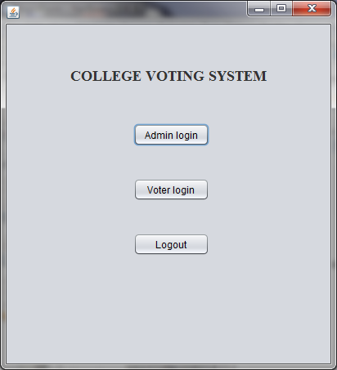
OUTPUT SCREENS: Main Login

Slide 8
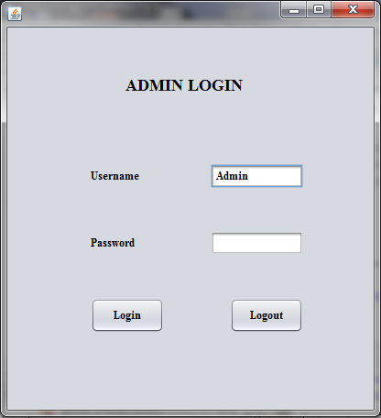

Slide 9
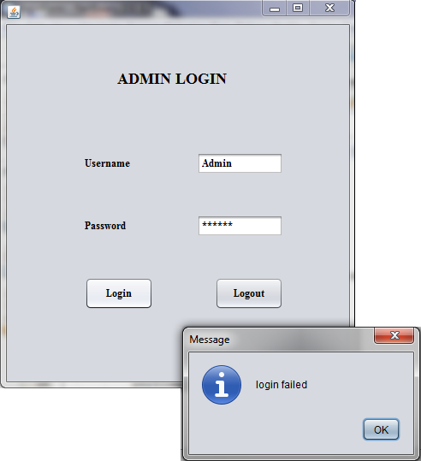

Slide 10
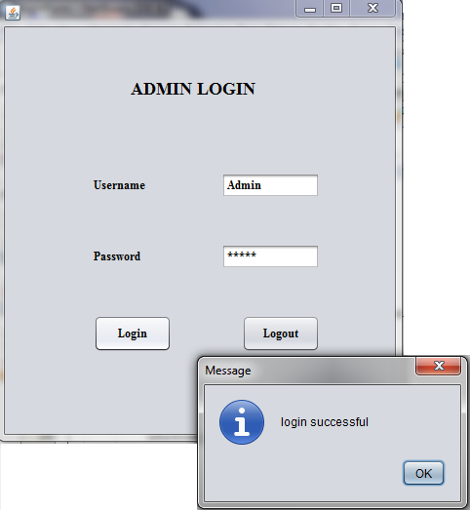

Slide 11
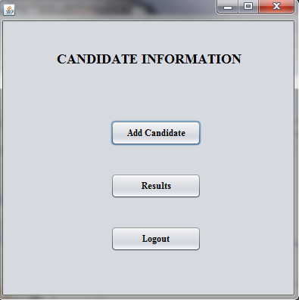

Slide 12
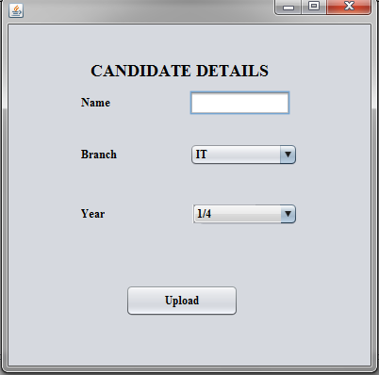

Slide 13
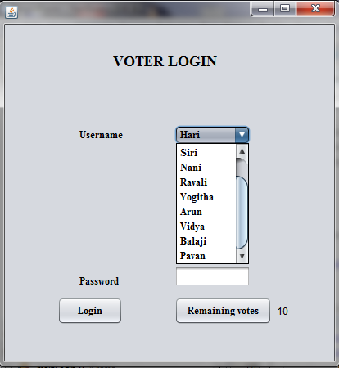

Slide 14
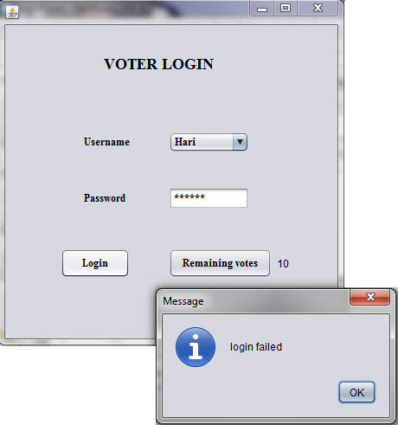

Slide 15
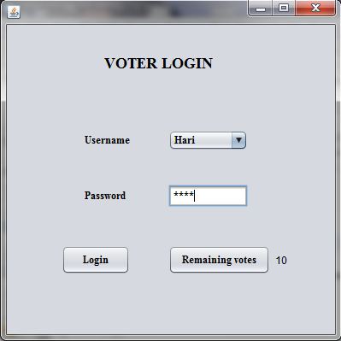

Slide 16
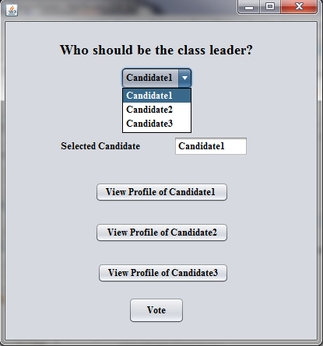

Slide 17
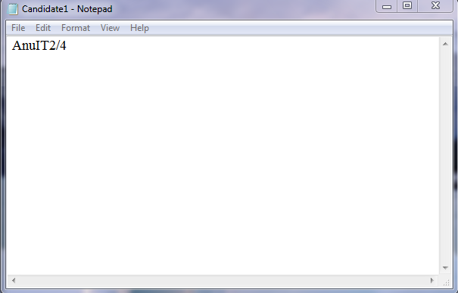

Slide 18
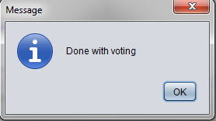

Slide 19
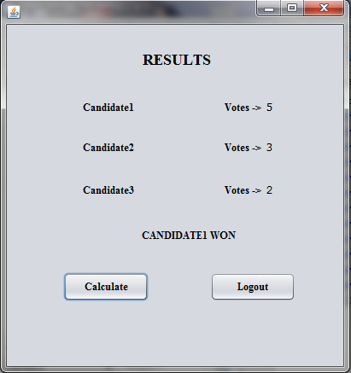

Slide 20
CONCLUSION
This project is designed such a way that an individual is not allowed to vote more than once.
Data in this project is completely secured.
Only authorized person can update the Candidate information.
FUTURE SCOPE
Making voting online.
Converting into app using Android studio.

Slide 21
REFERENCES:
JAVA THE COMPLETE REFERENCE, Herbert Schildt.
https://www.google.co.in/
https://www.instructables.com/id/How-to-Code-a-Basic-Program-in-Netbeans/

